Slide 1

Capstone Project:
Home Finder
www.collaberadigital.com

Slide 2
Personal BACKGROUND
(Name, Past Experience, Qualification, Career Summary)
Name : Delson James M. Tubiera
Past Experience : Freelance Web Developer on Tilden Tasks LLC. dba. WP
Tangerine
Qualification : .Net Developer
Career Summary :
Aspiring for the role of .Net Developer wherein I can demonstrate my skills in developing enterprise applications using Microsoft technology stack such as C#, ASP.Net MVC, Web API, WCF etc., along with HTML5/CSS3/JavaScript etc..

Slide 3
Personal BACKGROUND
(Name, Past Experience, Qualification, Career Summary)
Name : Mark Kim Eduard Blas
Past Experience : Internship on HPL Gamedesign Corporation
Qualification : .Net Developer
Career Summary : an aspiring Full Stack .Net Developer that showcase my skills and knowledge using HTML, CSS, C#, Asp.Net MVC, Web API, MsSQL.

Slide 4
Key Takeaways/Learnings from the Program (HTD)
Implementation and Connection of MsSQL
ASP.Net MVC
CRUD Operation
Pull and Push in Github Repository
Entity Framework Core
Entity Framework Core: DbContext
Identity Framework
Conventions in Entity Framework Core
One-to-Many Relationship
One-to-One Relationship
Linq-to-Entities Query
Seed Data
Migration
ASP.NET API

Slide 5
Problem Statement of the Capstone Project
The real estate industry is facing a challenge of providing a user-friendly and accessible platform for buyers and sellers to search, list, and manage their properties. Traditional methods of buying and selling properties are often time-consuming and complex, with limited options for browsing and comparing properties.

Slide 6
Approach Note
(How the candidate approached the program)
Using the real estate website with advanced search options, verified information about properties, and transparent pricing can provide a solution to these challenges. The website can serve as a centralized platform for buyers and sellers to connect and streamline the process of buying and selling properties, leading to increased efficiency and profitability in the real estate market.
Draw.io for creating diagrams like flowchart, ER Diagram and wireframes
ASP.Net MVC, Web API, MsSQL for developing the web application

Slide 7
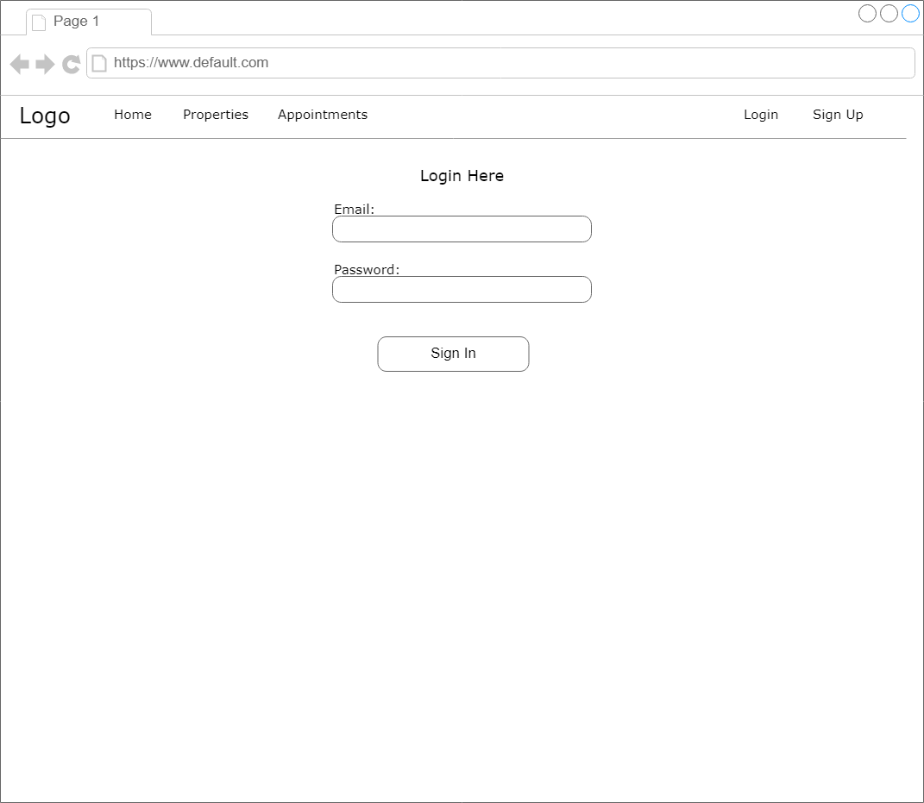
Wireframe/Architecture
Login

Slide 8
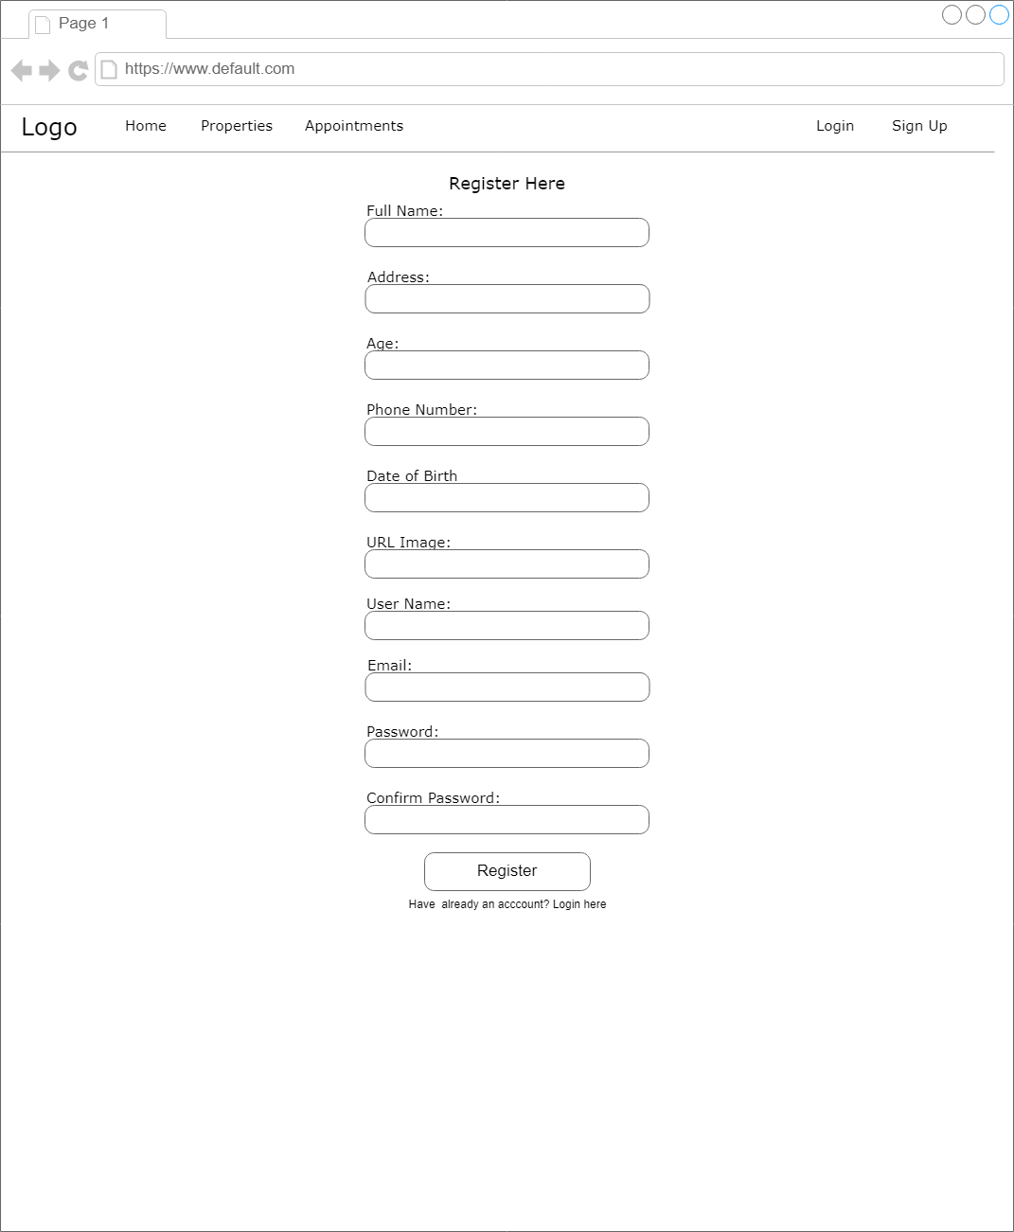
Wireframe/Architecture
Register

Slide 9
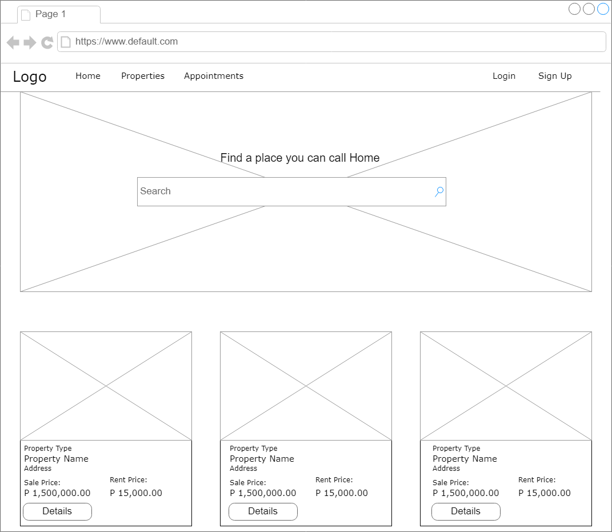
Wireframe/Architecture
Home/Properties

Slide 10
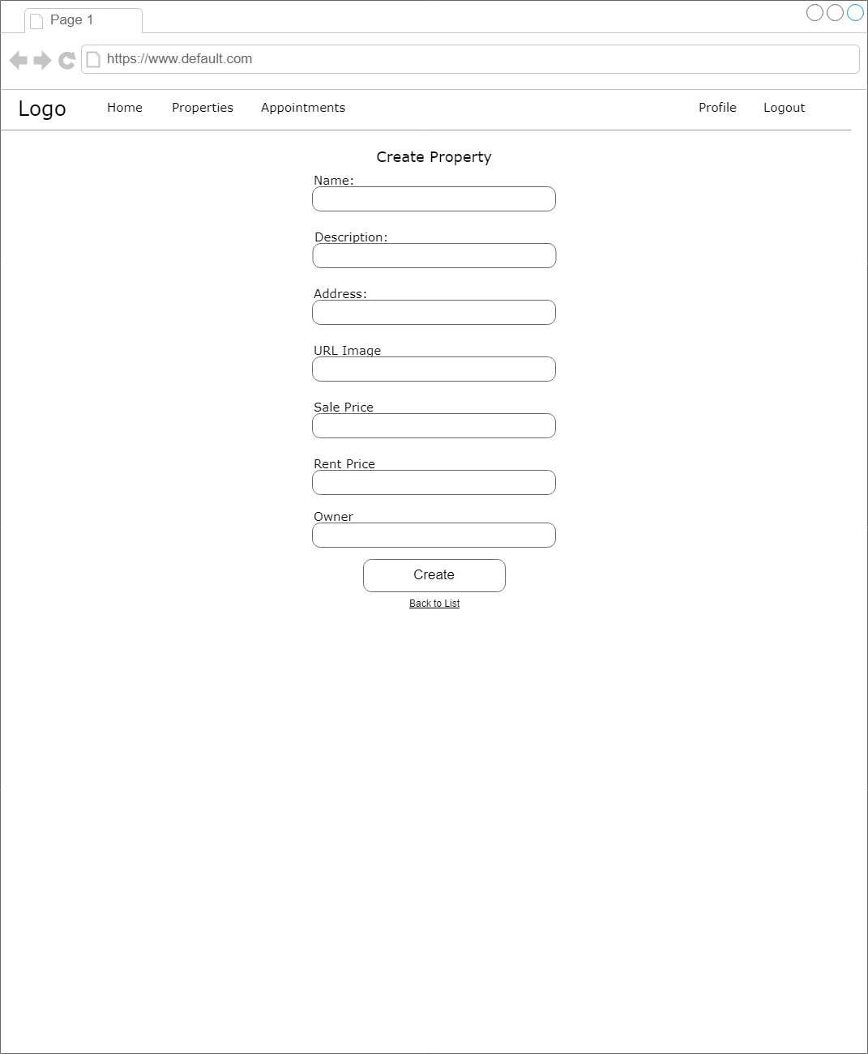
Wireframe/Architecture
Create Property
[owner and admin]

Slide 11
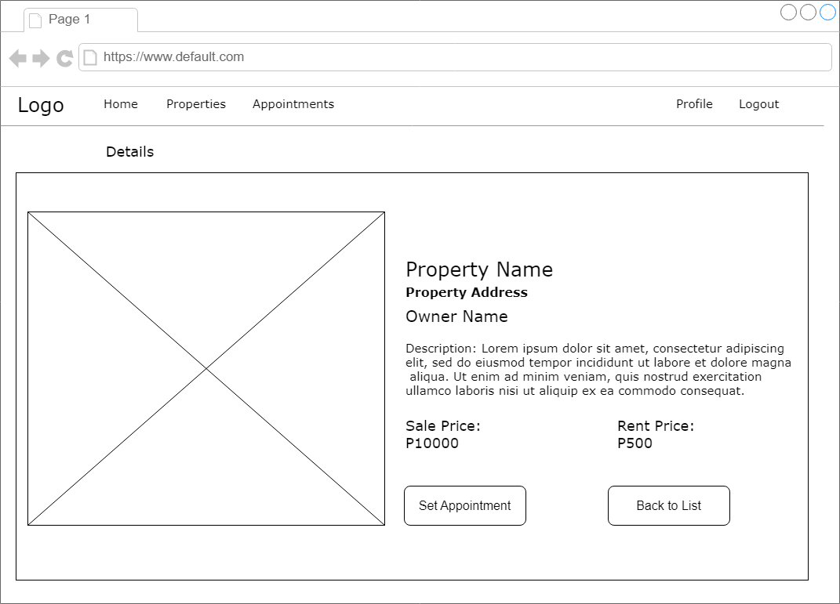
Wireframe/Architecture
Details of
Property

Slide 12

Wireframe/Architecture
Update Property
[owner and admin]

Slide 13
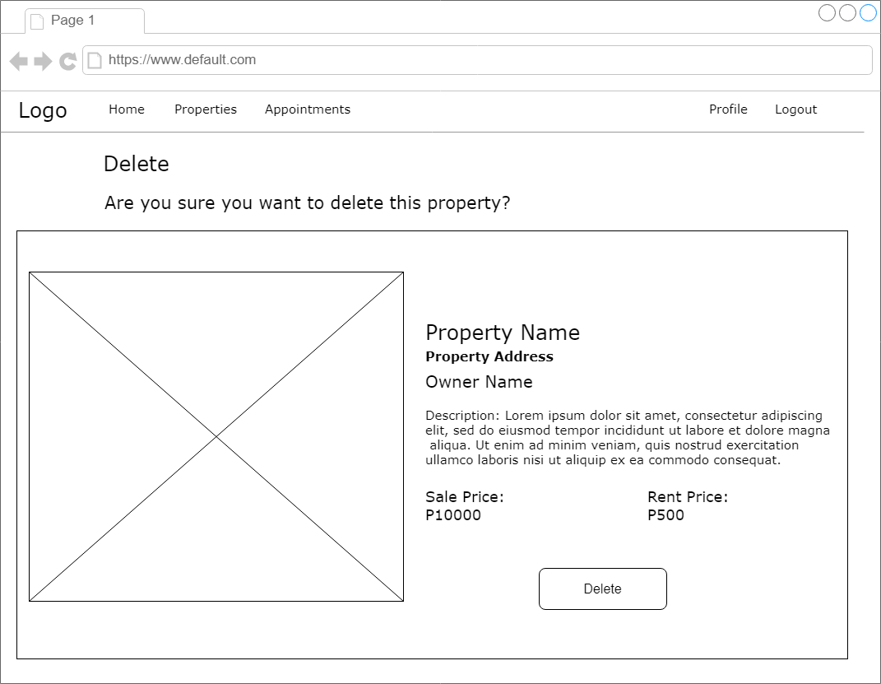
Wireframe/Architecture
Delete Property
[owner and admin]

Slide 14
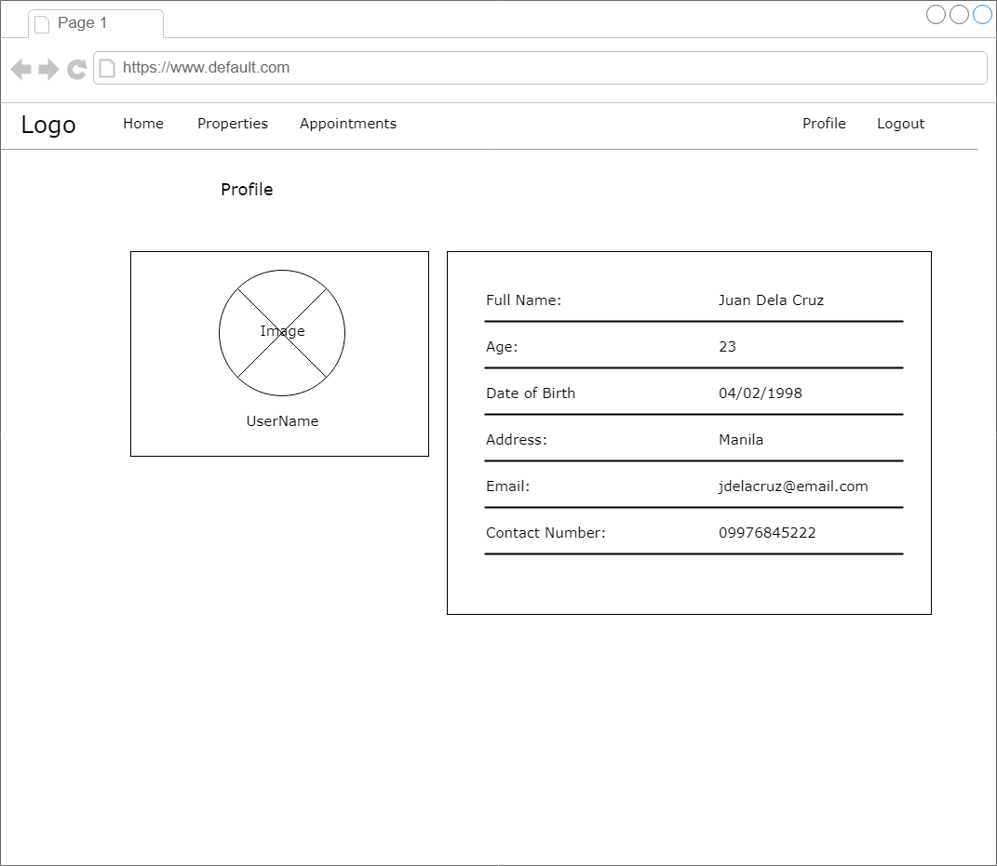
Wireframe/Architecture
Profile

Slide 15
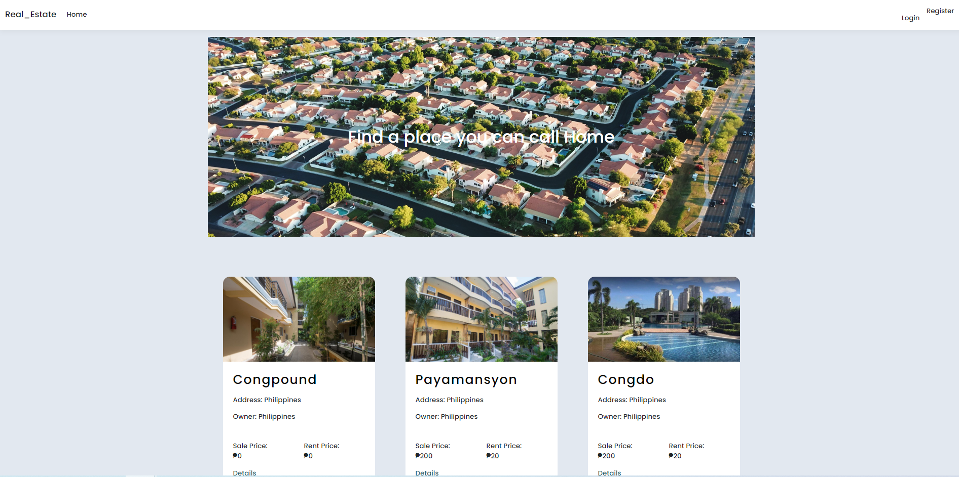
Important areas of the Project with screenshots
(Frontend, Database, Backend, Key Validations, Functionalities Etc.)
Home/Properties

Slide 16
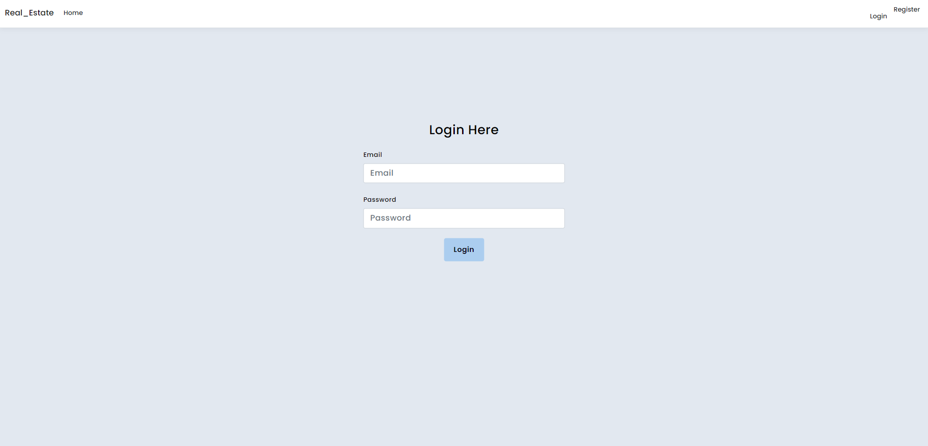
Important areas of the Project with screenshots
(Frontend, Database, Backend, Key Validations, Functionalities Etc.)
Login

Slide 17
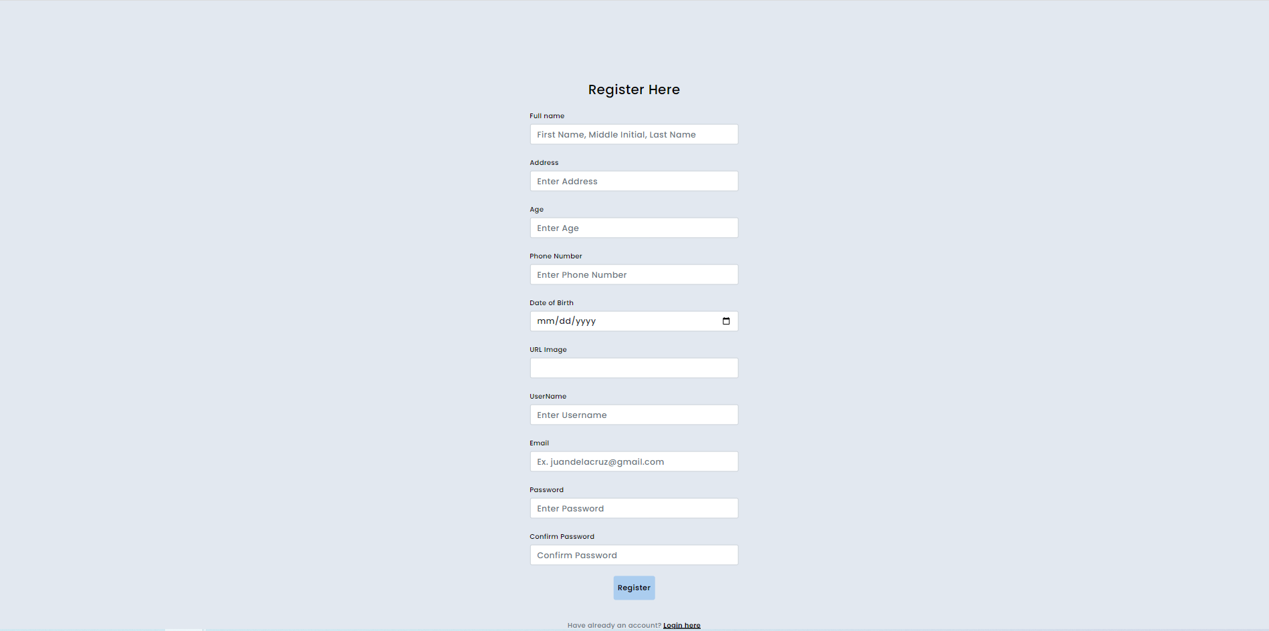
Important areas of the Project with screenshots
(Frontend, Database, Backend, Key Validations, Functionalities Etc.)
Register

Slide 18
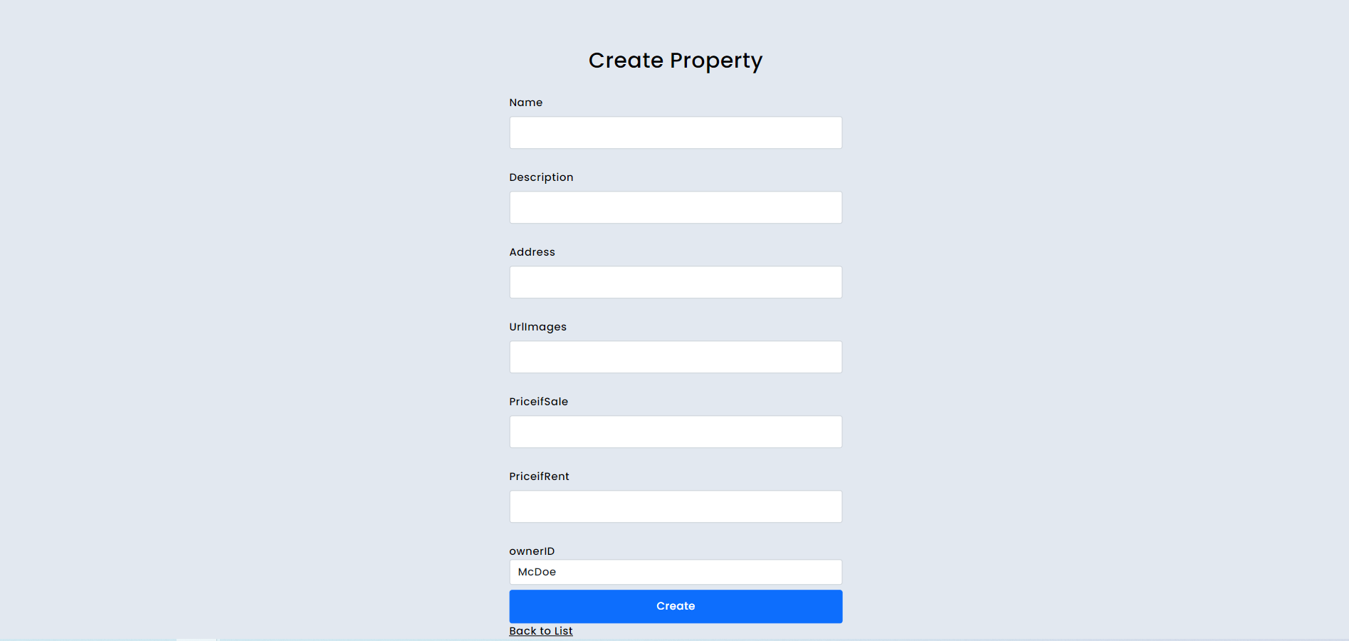
Important areas of the Project with screenshots
(Frontend, Database, Backend, Key Validations, Functionalities Etc.)
Create Property

Slide 19
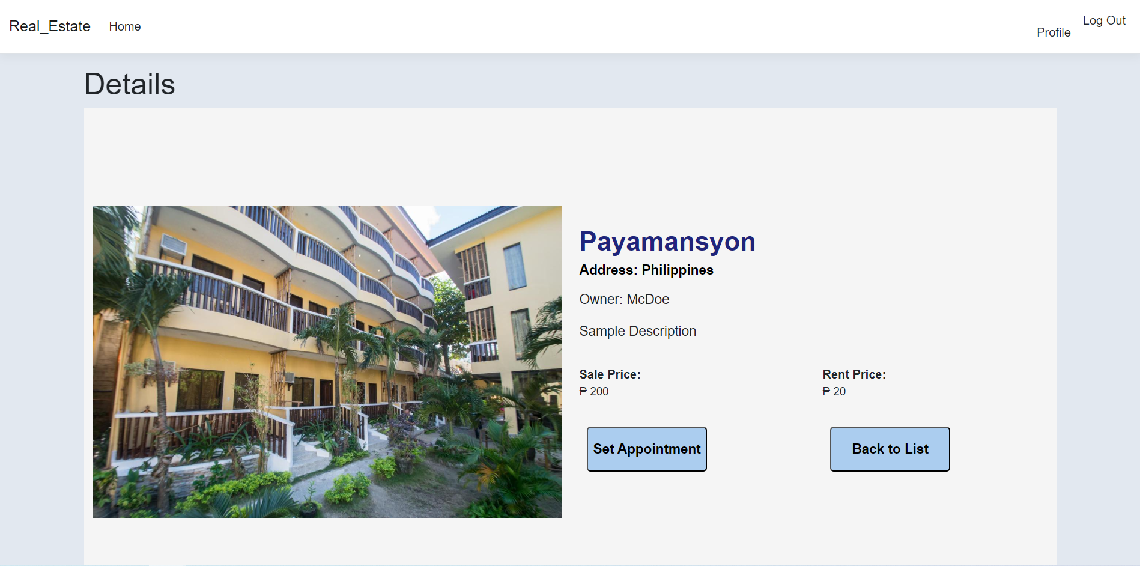
Important areas of the Project with screenshots
(Frontend, Database, Backend, Key Validations, Functionalities Etc.)
Details

Slide 20
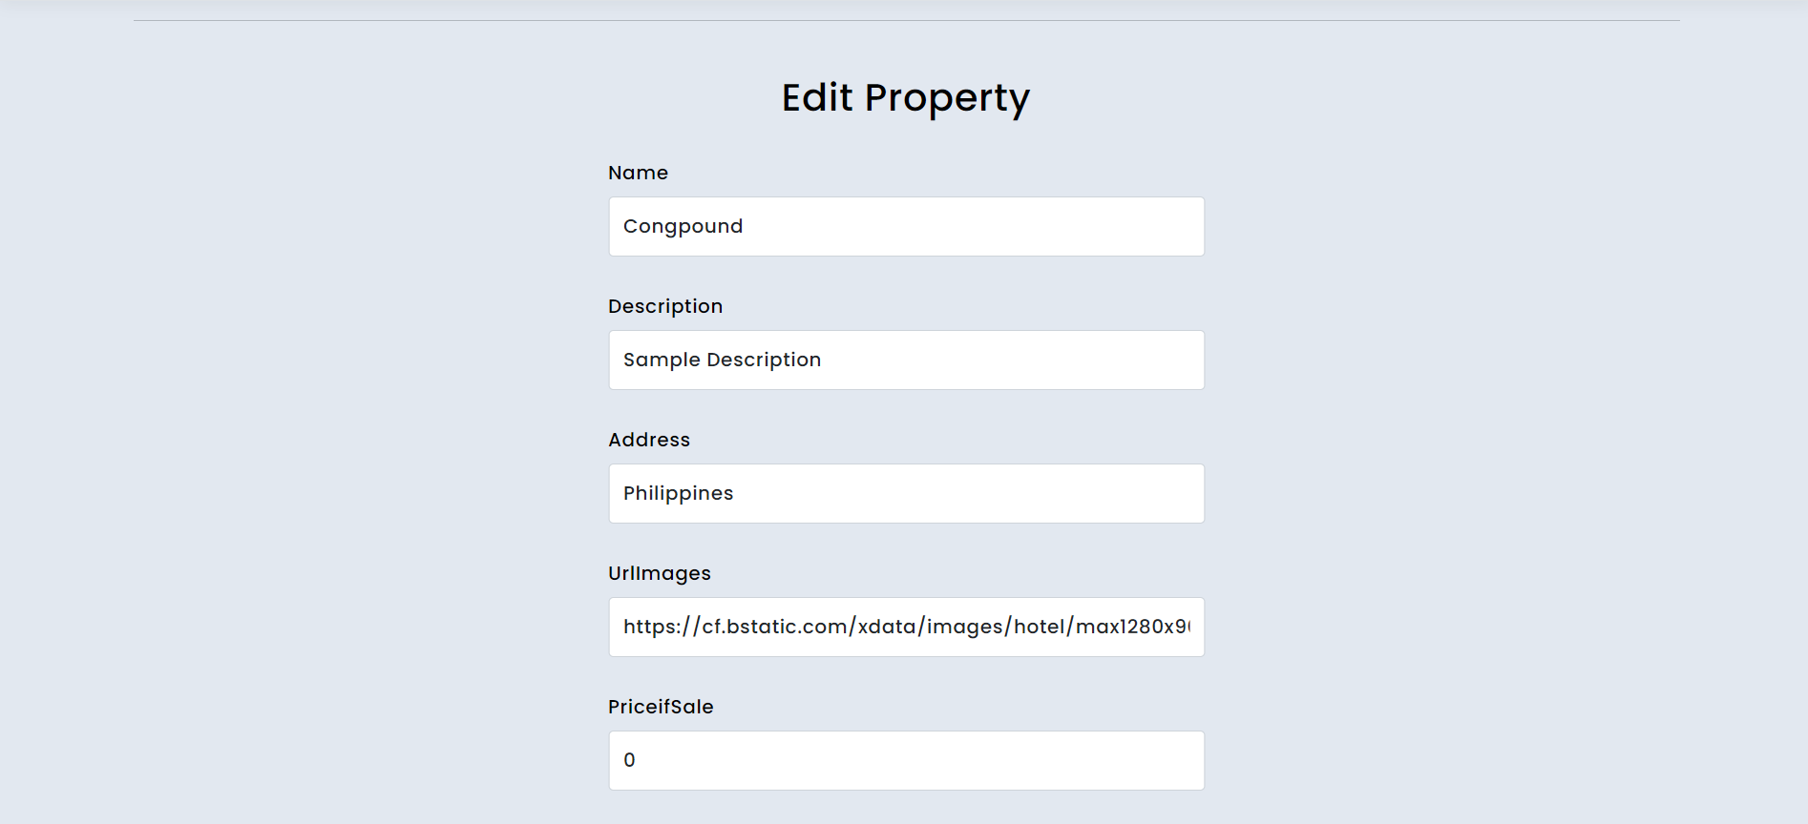
Important areas of the Project with screenshots
(Frontend, Database, Backend, Key Validations, Functionalities Etc.)
Edit Property [owner and admin]

Slide 21
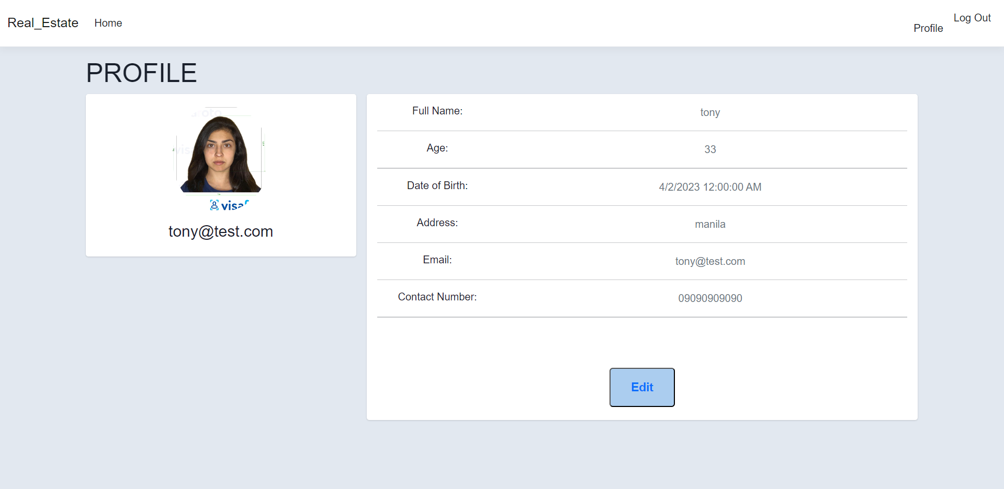
Important areas of the Project with screenshots
(Frontend, Database, Backend, Key Validations, Functionalities Etc.)
Profile

Slide 22
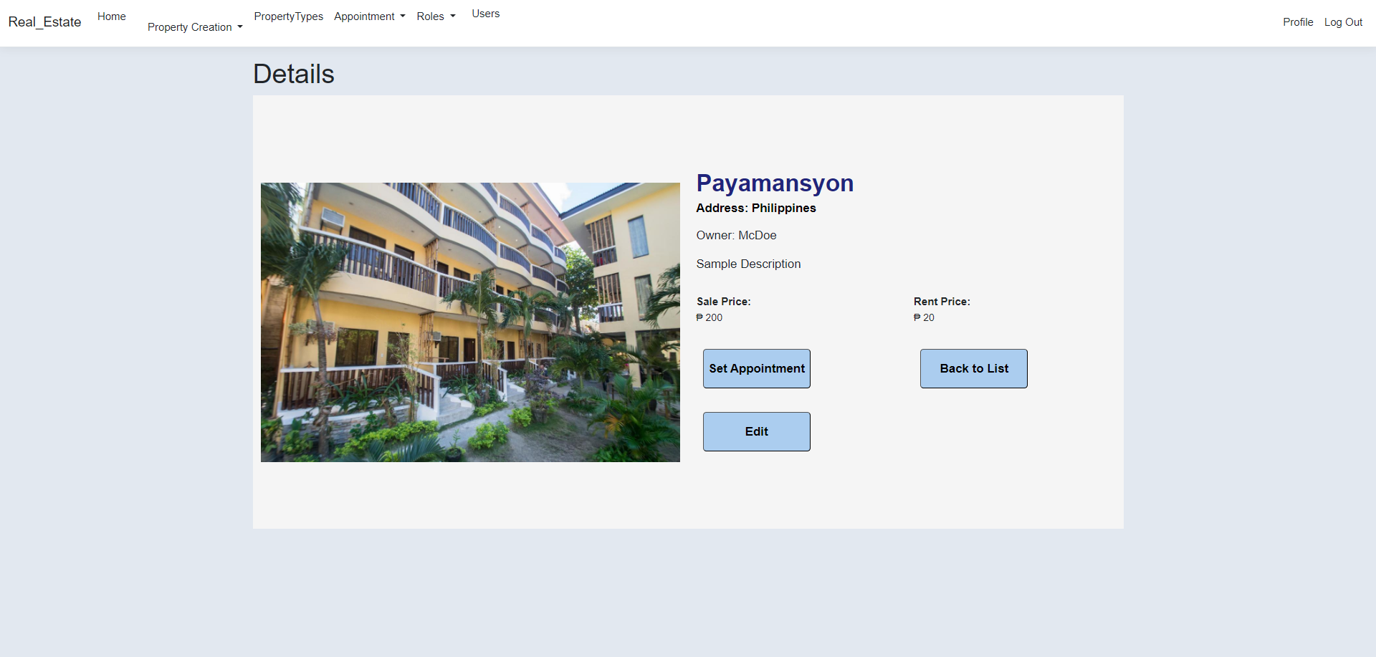
Important areas of the Project with screenshots
(Frontend, Database, Backend, Key Validations, Functionalities Etc.)
Admin

Slide 23
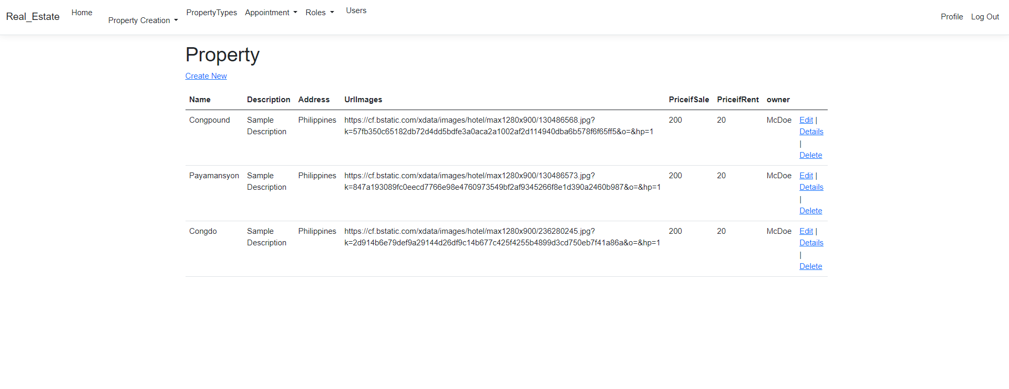
Important areas of the Project with screenshots
(Frontend, Database, Backend, Key Validations, Functionalities Etc.)
All Properties [admin]

Slide 24
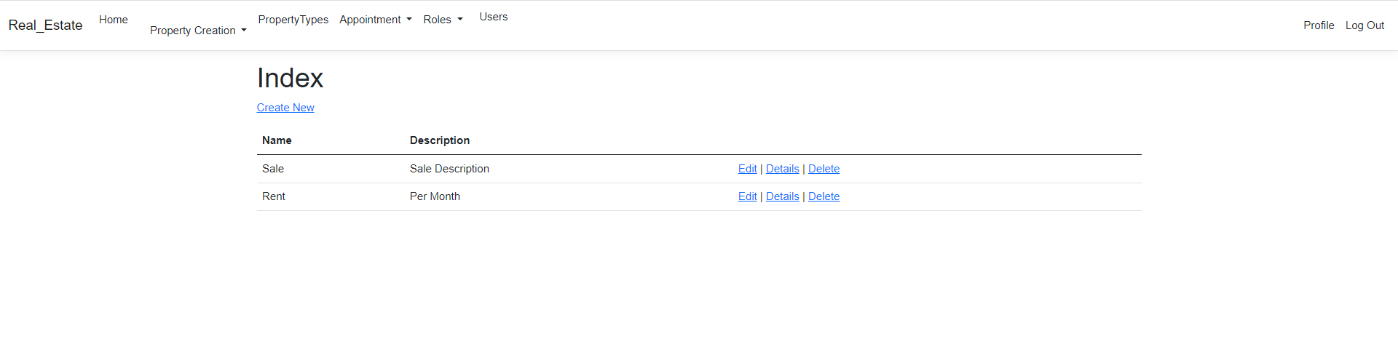
Important areas of the Project with screenshots
(Frontend, Database, Backend, Key Validations, Functionalities Etc.)
Property Types [admin]

Slide 25
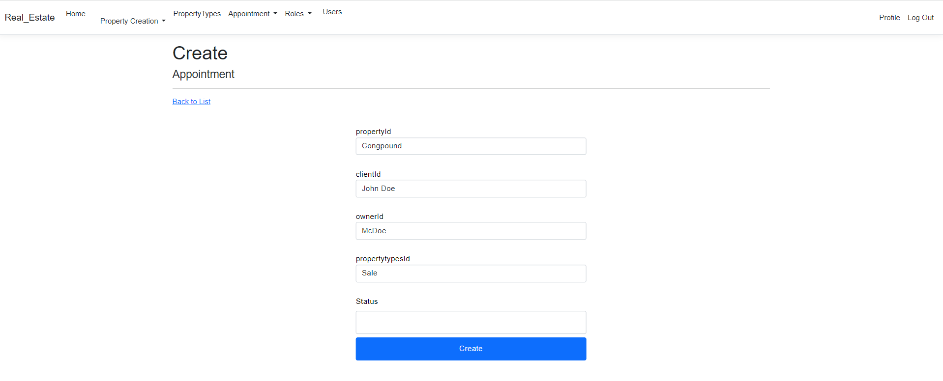
Important areas of the Project with screenshots
(Frontend, Database, Backend, Key Validations, Functionalities Etc.)
Create Appointment [client]

Slide 26
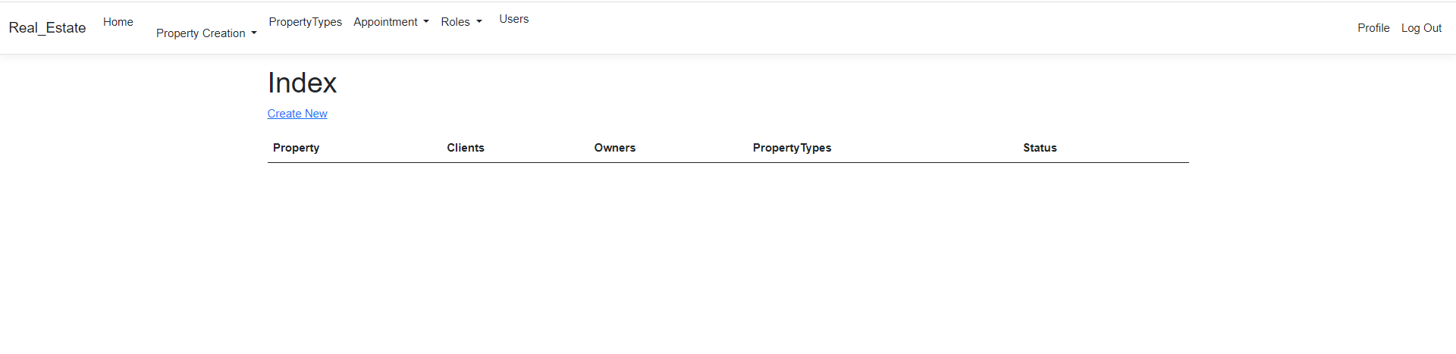
Important areas of the Project with screenshots
(Frontend, Database, Backend, Key Validations, Functionalities Etc.)
Appointment List [owner and admin]

Slide 27
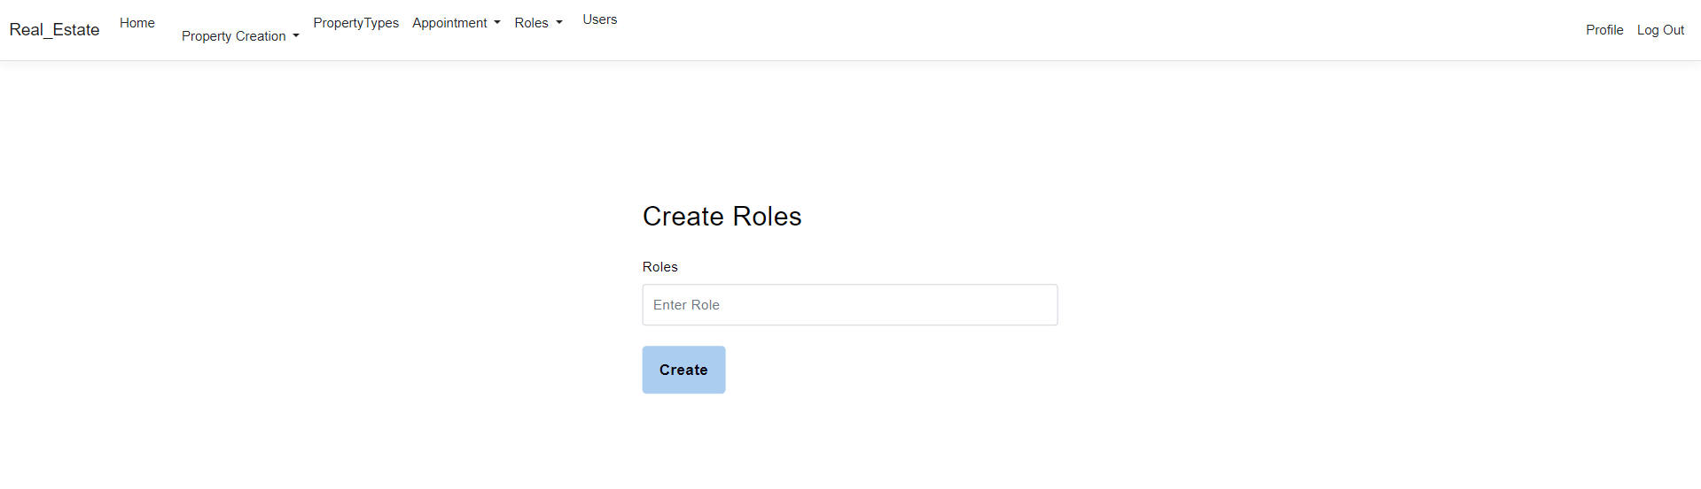
Important areas of the Project with screenshots
(Frontend, Database, Backend, Key Validations, Functionalities Etc.)
Create Roles [admin]

Slide 28
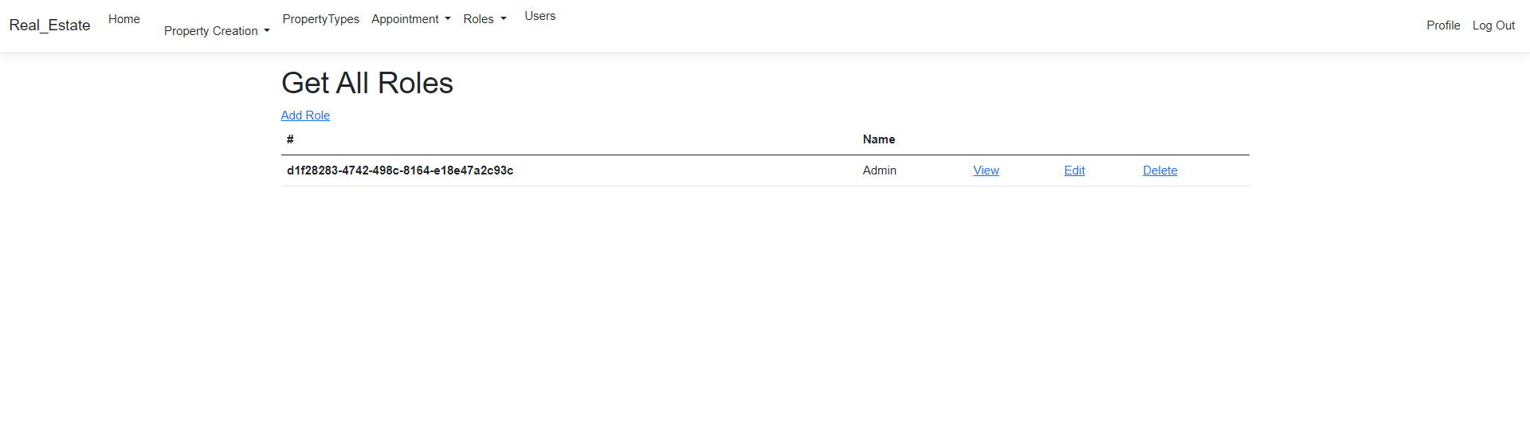
Important areas of the Project with screenshots
(Frontend, Database, Backend, Key Validations, Functionalities Etc.)
All Roles List [admin]

Slide 29
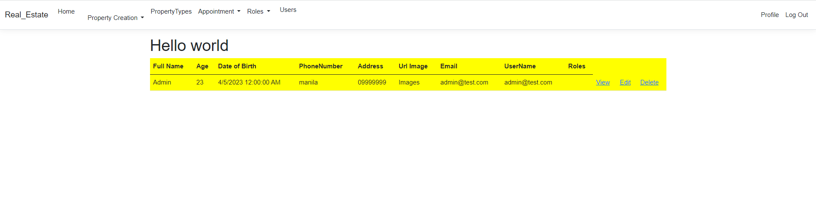
Important areas of the Project with screenshots
(Frontend, Database, Backend, Key Validations, Functionalities Etc.)
All User

Slide 30
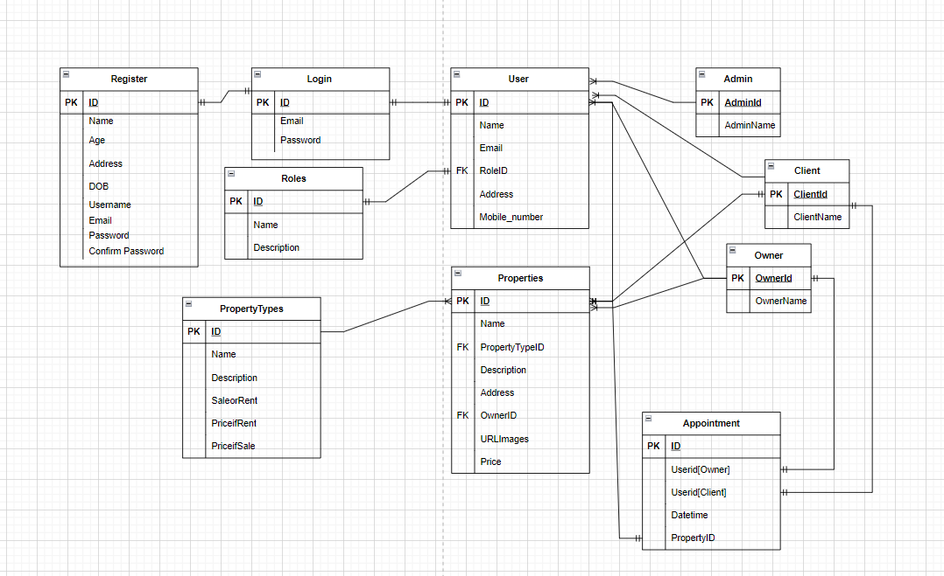
Important areas of the Project with screenshots
(Frontend, Database, Backend, Key Validations, Functionalities Etc.)
ER Diagram

Slide 31
FUTURE ENHANCEMENTS:
Maps of all the properties
Adding online appointment using google meet and zoom.
Notification
DIFFICULTIES/CHALLENGES:
Identity
Setup the User Roles.
Implementing Appointment Calendar

Slide 32
TO BE COMPLETE
Search bar / Sortings
Implementing the Appointment Calendar
Separating each role on perspective tables
Creating a functions that can easily setup roles for each user.
Implementing frontend for all views of the application.
Web Api
Docker Containerization
K8 Deployment

Slide 33
Conclusion
In conclusion, both owners and clients can profit greatly from having a real estate website. A real estate website can be utilized to promote properties, draw in potential customers, and promote the purchasing and selling marketing procedure. Additionally, it can offer clients useful information including property descriptions, images, and market trends. To sum up, having a real estate website is an important resource for anyone hoping to be successful in the competitive industry of real estate.

Slide 34
Thank You
www.collaberadigital.com

